Slide 1
MUSIC
STREAMING SERVICE
CSE 4508 - Project Proposal
Group - 12

Slide 2
TEAM MEMBERS
Fida Kamal
Ishrak Hossain
Alvi Aveen Khan
180041208
Front-End Developer
180041218
Back-End &
Front-End Developer
180041229
Back-End Developer

Slide 3
PROJECT DESCRIPTION
This project aims to create a music streaming website.
Anyone can search for artists, albums and songs and play music.
An administrator will upload music files.
Additional features are planned, and will be added depending on the remaining time:
User accounts, which will allow playlist creation, favorites list, etc.
Users can upload music to the public library.

Slide 4
TECHNICAL STRUCTURE
Front-End
Back-End
HTML, CSS and JavaScript will be used for the front-end along with the React JS Framework
Python will be used for the back-end along with the Flask Framework
Database
MySQL will be used as a database with the help of XAMPP

Slide 5
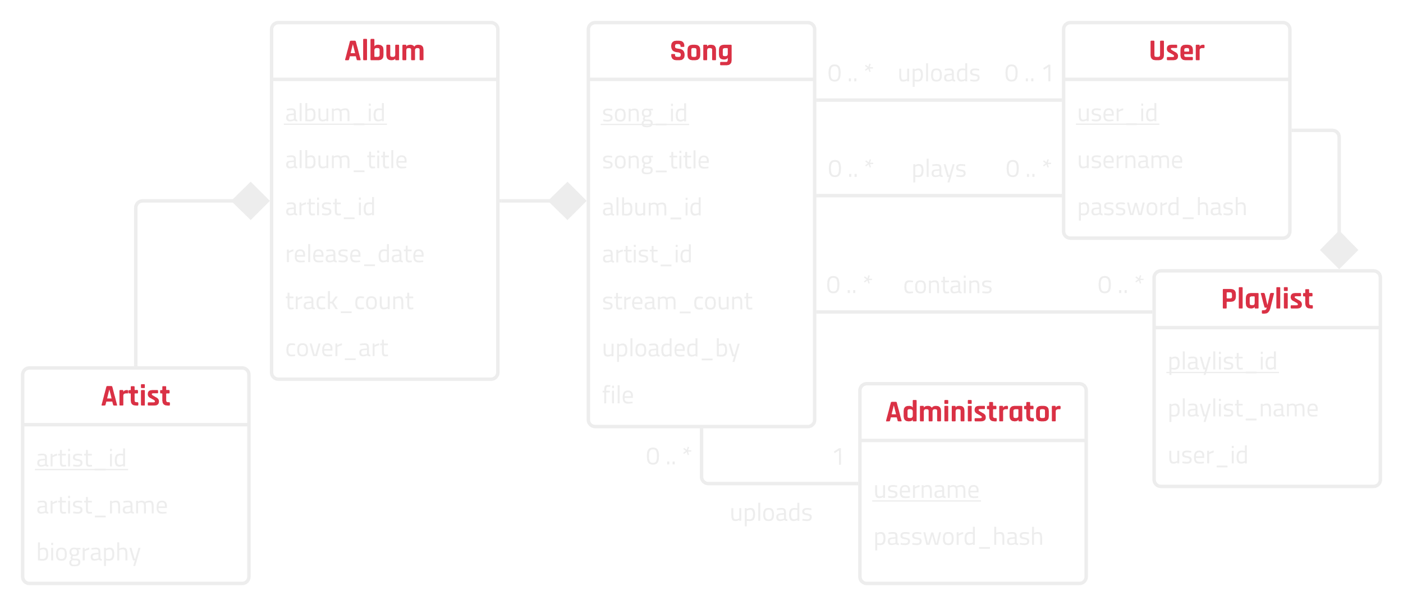
UML Diagram

Slide 6
Thank You!

